Slide 1
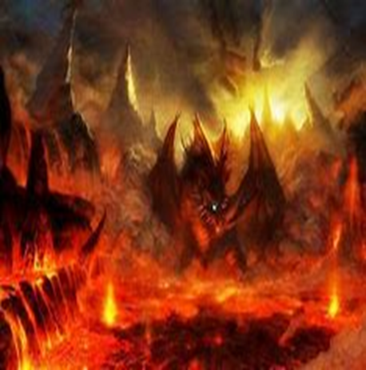
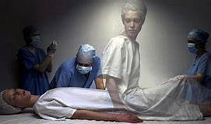
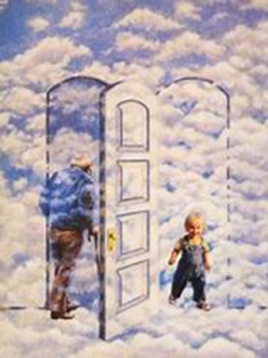
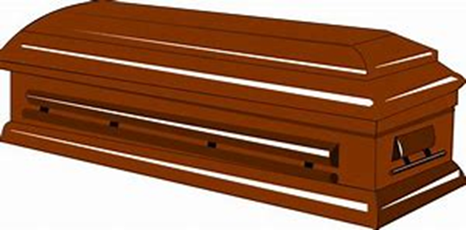
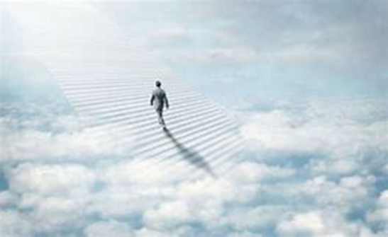
What do you think happens when we die?

Slide 2
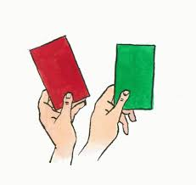
Starter Task:
Orthodox, reform or both!

Slide 3

Judaism
Beliefs
• beliefs about God
• nature of human beings: yetzer tov; yetzer harah; free will; suffering
• beliefs about Covenant
• judgement; the Messiah; the Messianic Age; Olam Ha’ba
Practices
• living according to the Commandments
• Rosh Hashanah; Yom Kippur
• worship: Shabbat; synagogue

Slide 4
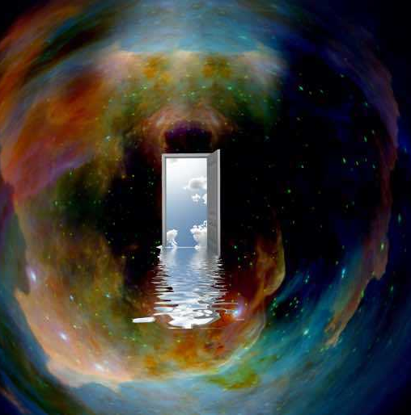
22.9.22 Judgement
God is the judge of humanity. Upon death, it is believed that all Jewish people will be judged by God.
This final judgement decides where the Jewish body/soul will go.
But its not that simple!.....
“God will bring every deed into judgement … whether it is good or evil.”
Ecclesiastes 12:14

Slide 5
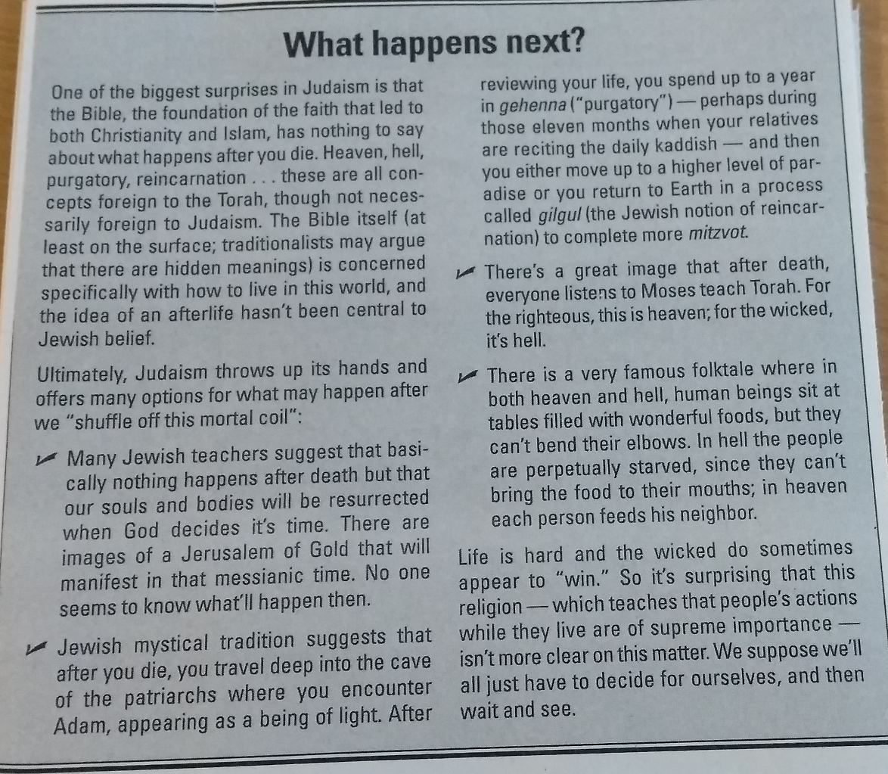
Lets learn more about this idea.

Slide 6
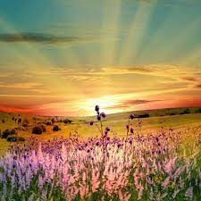
This spiritual afterlife is called Olam ha’ba, the world to come.
But Jews disagree about what this actually means.
Some Jews believe that they will be judged as soon as they die, while others believe that they will be judged on the Day of Judgement when the messiah or messianic age happens. (More about that later!)
Although many Jews believe that they will be punished or rewarded after death for the way in which they have lived their lives, but there is no clear teaching about this.
The idea of judgement is not central to Jewish belief, it is a faith primarily focused on life here and now rather than on the afterlife.

Slide 7
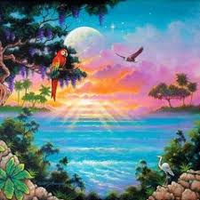
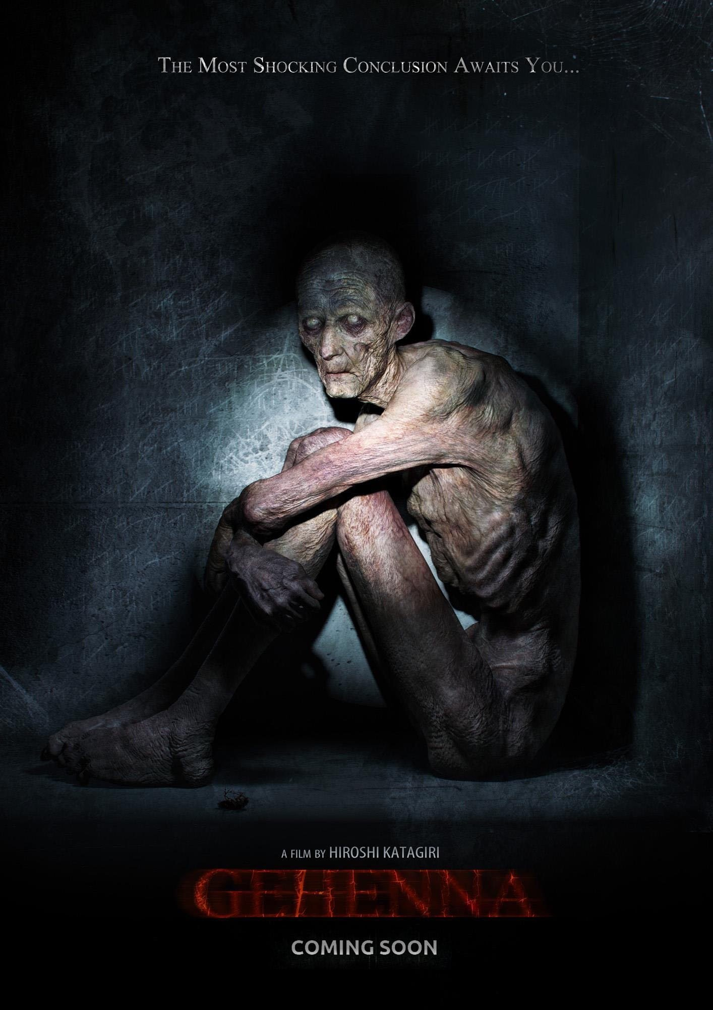
One view is that good people will enter Gan Eden (heaven) and wicked people will go to Gehenna (hell) after the last judgment.
Add another view of the Olam ha’ba from the information sheet.

Slide 8
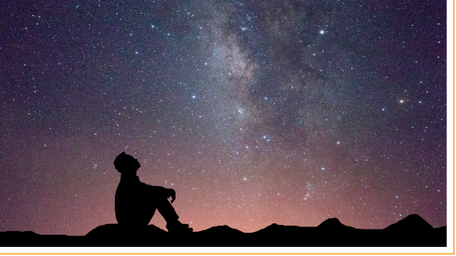
The other viewpoint is linked to the idea of the messianic age.
Ultimately Jews believe that the importance of life is the way in which it is lived on earth.
Whatever happens after death is in God’s hands and should be left to him to arrange.

Slide 9
Judaism
Beliefs
• beliefs about God
• nature of human beings: yetzer tov; yetzer harah; free will; suffering
• beliefs about Covenant
• judgement; the Messiah; the Messianic Age; Olam Ha’ba
Practices
• living according to the Commandments
• Rosh Hashanah; Yom Kippur
• worship: Shabbat; synagogue

Slide 10
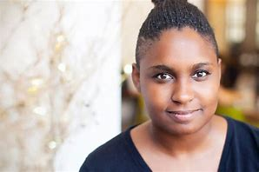
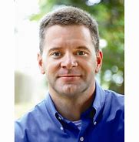
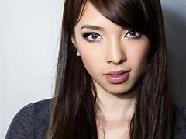
Which quote do you most relate to and why?
“Life is nasty, pointless and short, any hope
that it will improve is mere fantasy.” Leah
“We need to have hope for a better future because
otherwise we will feel a sense of hopelessness.
Hope is essential. ” Rob
“Sometimes events can happen in life
that bring about better experiences, that change the future
But this is rare, life is just about survival.” Sian

Slide 11
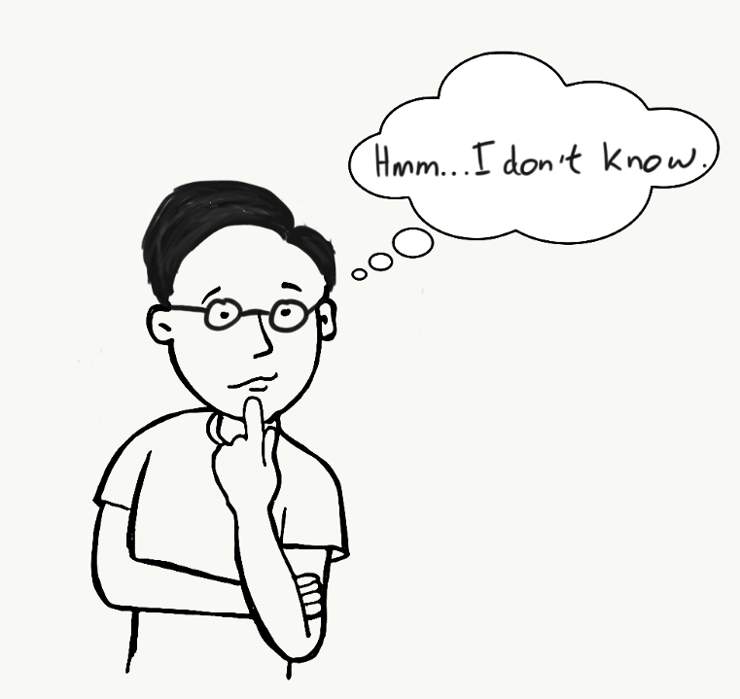
Jews believe there is always hope.
They are waiting for an event they call the “Messianic age” or the “Golden age.”
What do you think a
Golden or Messianic age will look like?

Slide 12
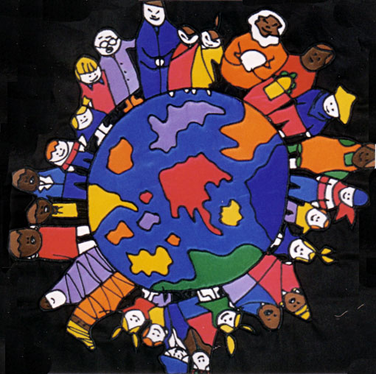
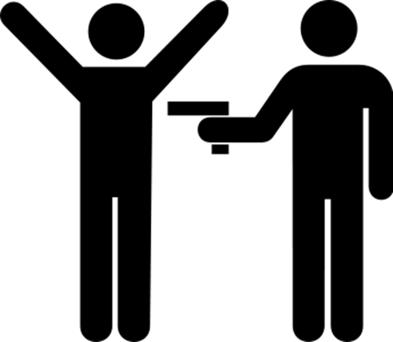
The Messianic Age or Olam ha’ba
The Messianic age is a term used by Jewish people to describe a future time on earth.
In this ideal and perfect world all the difficult problems will be solved.
There will be no crime or war or poverty.

Slide 13
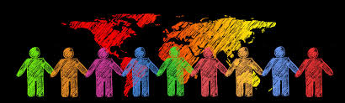
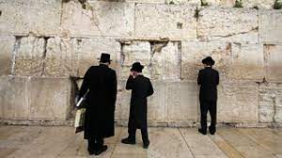
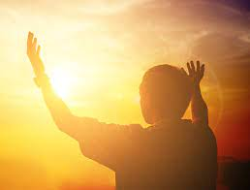
There will be peaceful co-existence of all people.
All of the Jewish people will return from their exile among the nations to their home in Israel.
In the Olam Ha’Ba, the whole world will recognize the Jewish God as the only true God, and the Jewish religion as the only true religion.

Slide 14
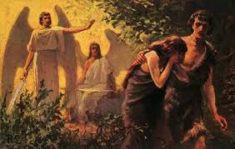
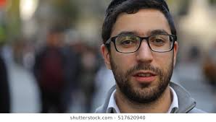
It is the kind of world God always wanted.
Remember Genesis and the creation story?
“From the dawn of time, G‑d envisioned for Himself a "dwelling place" right here on Planet earth.
The Messianic age is the realisation of just that.”

Slide 15
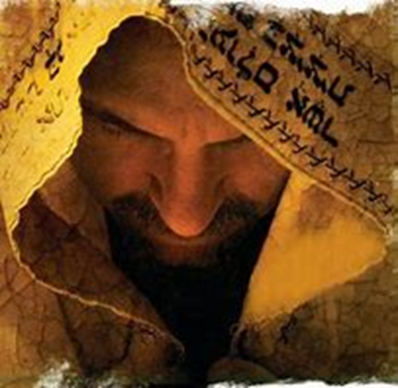
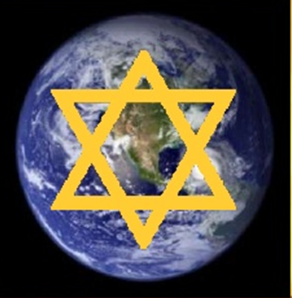
Some Jews believe this is an actual person others believe it a period of time.
?
How do you think this distinction is decided?

Slide 16
A person: Orthodox tradition
This time will begin because a Messiah will come to earth.
Messiah means ‘anointed’ (chosen) one and the Hebrew word for Messiah is ‘Mashiach’.
Judaism teaches that at some time in the future, a Messiah (messenger or representative of God) will physically come to earth.
The Torah contains no specific reference to him but in general, the following passages are accepted by Jews as referring to the Messiah:
Isaiah 2, 11, 42; 59:20
Jeremiah 23, 30, 33; 48:47; 49:39
Ezekiel 38:16
Hosea 3:4-3:5
Micah 4
Zephaniah 3:9
Zechariah 14:9
Where do you think they get this idea from?

Slide 17


Slide 18
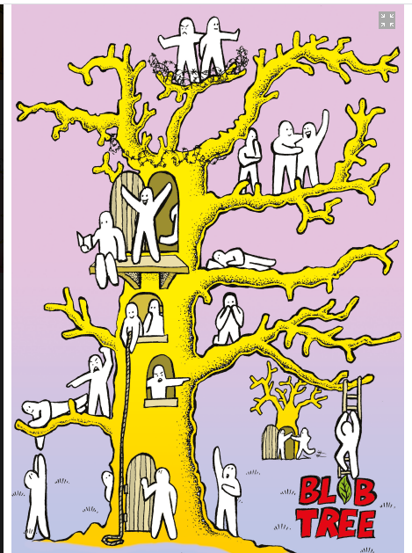
Starter task: Which blob best represents you and why?

Slide 19
Judaism
Beliefs
• beliefs about God
• nature of human beings: yetzer tov; yetzer harah; free will; suffering
• beliefs about Covenant
• judgement; the Messiah; the Messianic Age; Olam Ha’ba
Practices
• living according to the Commandments
• Rosh Hashanah; Yom Kippur
• worship: Shabbat; synagogue

Slide 20
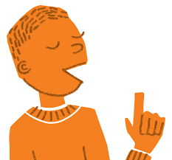
What do you remember and understand about the Jewish view of these concepts?
Judgement; the Messiah; the Messianic Age; Olam Ha’ba
“God will bring every deed into judgement … whether it is good or evil.”
Ecclesiastes 12:14

Slide 21
“ I will be their God and they will be my people.” Ezekiel
There are many interesting ideas but for Jews the key beliefs are:
He will be born, so a real physical person.
He will be Jewish.
He will have the authority of God.
He will be charismatic and inspires others to follow their example.
He will judge fairly and make righteous decisions.
He will be a ruler that introduces peace that lasts forever.
He will restore the land to the Jewish people.

Slide 22
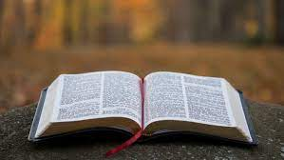
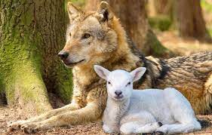
Isaiah 11: 1-12 Lets read it.
Task: Individual research
Write down the reference and 3 points you have learnt from this passage about the messiah or this golden age.

Slide 23
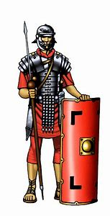
It is helpful to understand when this idea developed. Life under the Romans
The Roman army had conquered Jewish land and Jewish people had to live under the laws and rules of the Roman Empire
Romans worshipped many Gods
Life could be good if you adapted to their ways: roads, baths, entertainment, cities BUT many Jews hated the Romans for occupying their land and enforcing many strict (non-Jewish) rules and punishments
The Jewish people hoped a great leader would be sent by God to help them, and the idea of a messiah developed around this time.
Notes:
How do you think jewish people felt? Why?

Slide 24

When will the Messiah appear?
Some Jews believe that God has already decided when the Messiah will appear on Earth but that the exact date is unknown to humans.
After a time of war and hardship.
Others agree that the Messiah will come to Earth but only when humans have proved themselves to be worthy of him by improving their actions and behaviour.
If a single Shabbat is observed correctly by every Jewish person.
A few think that he will appear when humanity is most in need.

Slide 25
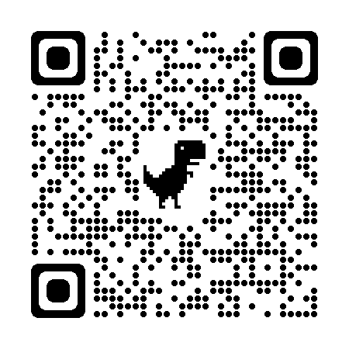
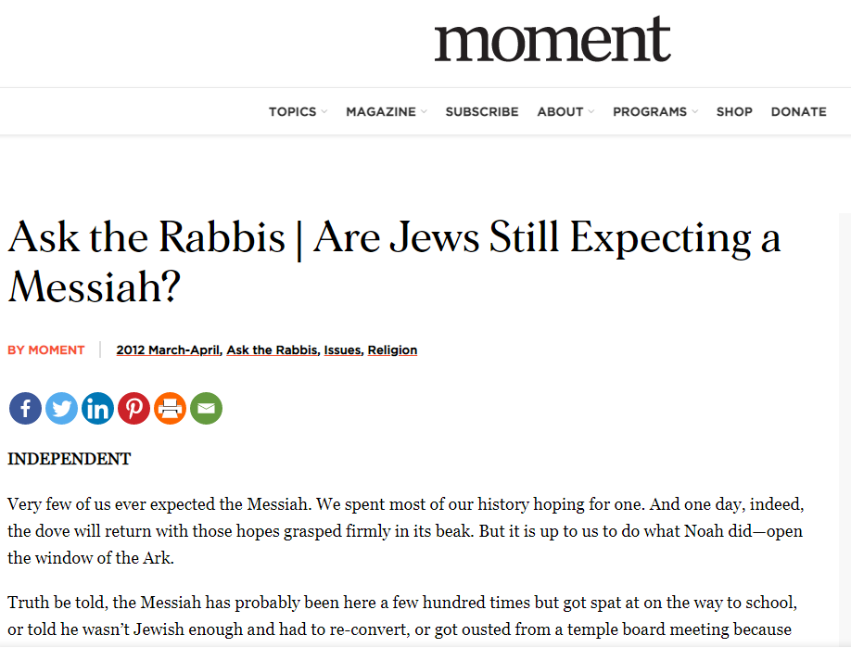
The Messiah must arrive before the year 6000 from the time of creation.
In Orthodox Jewish belief, the Hebrew calendar dates to the time of creation, making this correspond to the year 5782 on our calendar.
https://momentmag.com/ask-the-rabbis-are-jews-still-expecting-a-messiah/

Slide 26
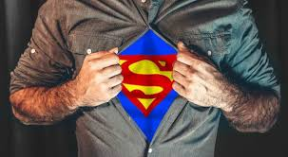
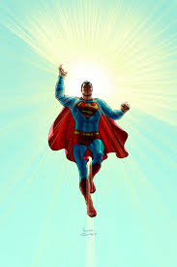

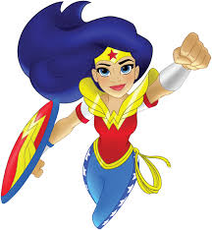
Is the concept of a super hero type of person appealing to you or not?

Slide 27
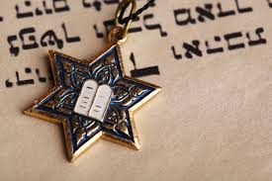
A time: Reform
They believe that instead of praying for a Messiah, they should pray for a
Messianic Age.
They have given up hope of an actual person and believe that, in
partnership with God, it is up to them to make the world into a place of peace and justice.

Slide 28
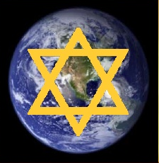
A time that will come for Jews:
• The Messianic Age is not a person but a fact, a time.
• During this time there will be no more wars.
• No one will be persecuted.
• Everyone will have enough food and water.
• Judaism will be the religion of the people.
This is a very different viewpoint, but some elements are the same.
What are they?

Slide 29
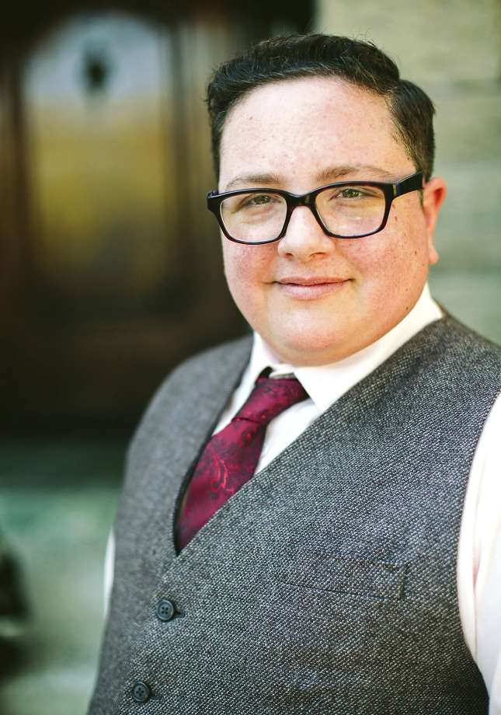
A reformed Jew
“We cannot wait nor do we expect a personal Messiah. We continue to have faith that, in spite of the unspeakable evils committed against our people and the sufferings endured by others, the partnership of God and humanity will ultimately prevail…. We bring Torah into the world when we strive to fulfill the highest ethical mandates in our relationships with others and with all of God's creation.”

Slide 30
Read through Source A, B and C.
In what ways are they suggesting the concept of the Messiah/ the Messianic age impacts a Jew today?
Make a note of at least four ways this belief influences Jewish practices.
Subtitle: The Impact of the Messianic belief on Jewish practice.

Slide 31
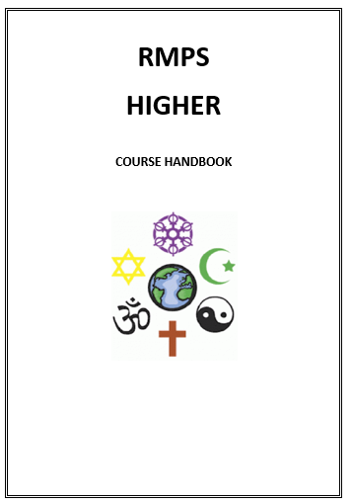
Essay practice:
Explain the relationship between two beliefs you have studied. 10 marks (2017)
Analyse two things 10 mark essay.
Paragraph 1
Explain one of the practices or beliefs using at least three key pieces of KU
Paragraph 2
Explain the second of the practices or beliefs using at least three key pieces of KU
Paragraph 3
Explain how these two link together using two detailed points of analysis.
Beliefs
• beliefs about God
• nature of human beings: yetzer tov; yetzer harah; free will; suffering
• beliefs about Covenant
• judgement; the Messiah; the Messianic Age; Olam Ha’ba

